Slide 1
Understanding emotions
CWP Adult Autism Assessment and Diagnostic Service

Slide 2
Presentation overview
In this presentation we will discuss understanding emotions and strategies
We will explore alexithymia and interoception and the part they play in processing and interpreting emotions
Opportunity for group discussion on the above and individual strategies.

Slide 3
Misconceptions
Some people think that autism means that the person cannot feel emotion or cannot feel ALL emotions, and therefore have no interest or ability in fostering relationships with others or making friends.
This myth is simply not true. Autistic people are completely capable of feeling all emotions.

Slide 4

Autism and Emotions
It is well known that a lot of autistic / neurodiverse people find it challenging to recognise how they feel, and identify their emotions, unless they are extreme emotions, whereas some people are extremely sensitive to emotions. A lot of people struggle to regulate their emotions. This links to our interoception.

Slide 5

Interoception
Interoception has been recognised as the 8th sensory system and gives us the ability to feel and register what is happening inside our body.
We have special nerve receptors all over our bodies including around our internal organs, bones, muscles and skin. These receptors send information to the brain which uses sensations to determine how we feel.

Slide 6

Some people, may be hyper-sensitive and have good actual interoception but feel these sensations in great detail, so it becomes too much, to the point that they feel really overwhelmed and can’t work out how they feel. They may eat or drink all the time, or frequently need to use the bathroom, having an impact on their functioning.

Slide 7
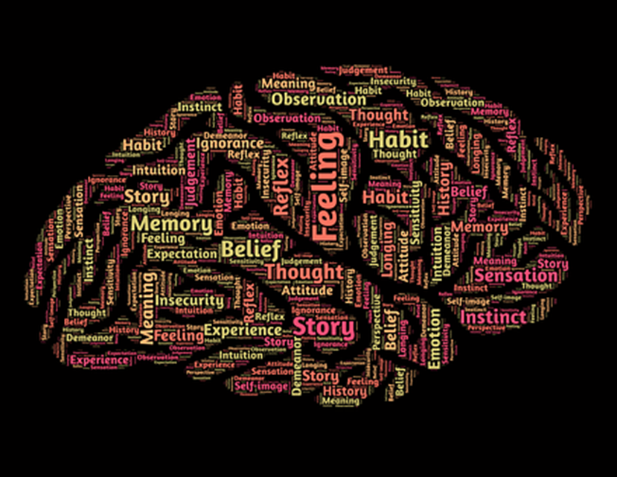
How does this link to our emotions?
The purpose of the interoception system is to help our bodies stay in an optimal performance state and to recognise when we need to make a change.
The signals that interoception provide are really clues of what is going on in our body, and something that we can react to in terms of a physical action needed such as eating, or to display emotions.

Slide 8

For example, how do you know that you are feeling anxious?
you often recognise:
a tight chest,
fast heart rate,
quicker breathing,
a flutter in your tummy,
tense muscles,
increased fidgeting,
Sweating,
or pacing etc.

Slide 9

We feel all these but put them together in context and understand that we feel anxious. It is the interoception that helps us feel these physical things in our body, which then helps us understand that we are anxious.
Interoception helps us feel many things such as pain, hunger, thirst, feeling full or empty, if we are tired, or alert, if we are calm, sad, anxious, or angry etc.

Slide 10

Strategies to improve interoception:
• Mindfulness has been shown to help people engage with their internal senses, and develop a better awareness of things like breathing rate, heart rate etc, in a relaxed environment. Research has shown that incorporating these into daily routines can help develop greater awareness of interoception.
• Using Sensory strategies - Proprioceptive strategies (deep pressure) is helpful at calming the system when it is over-responsive, and also regulating arousal level when it is under responsive.
• Building awareness of physical signs of emotions possibly with the help of a supporter, to slowly become more aware of the signs, and to identifying helpful strategies in relation to these – for example, faster heart beat, faster breathing means you could be anxious.

Slide 11

Impact on emotions:
Research has shown that our ability to read our own physical signals directly relates to how well we can identify and regulate our emotions. This in turn directly impacts on our ability to accurately read another person’s physical and emotional cues.
Just like the other emotions, a person can have modulation difficulties within this system.

Slide 12

“Alexithymia is a term to describe problems with feeling emotions. In Greek, it loosely translates to “no words for emotion.” It is estimated that 1 in 10 people has alexithymia, but it is much more common in those with depression and in autistic people. 1 in 5 autistic people have alexithymia”.
“People who have alexithymia may have trouble identifying, understanding and describing emotions. They may also struggle to show or feel emotions that are seen as socially appropriate, such as happiness on a joyous occasion”.
(Autistica 2021)
Online alexithymia questionnaire:
https://embrace-autism.com/online-alexithymia-questionnaire/

Slide 13

If physical sensations are more difficult to recognise in ourselves, then the clues to emotions wont be noticed or felt until the physical sensation is much stronger;
or everything feels very muddled so identification of a certain emotion is very difficult.

Slide 14
Differences with emotional regulation in autistic adults can be represented by many significant difficulties such as, emotional lability: frequent meltdowns or sensory overload, tendency to cry, difficulty to express themselves, rapid mood changes and a tendency to be frustrated if demands are not met.

Slide 15
Strategies for decoding emotions:
A common difficulty amongst autistic people is recognising and naming emotions in themselves and others. If you struggle to recognise your own emotions, you are highly likely to struggle recognising emotions in others. Therefore, to improve this skill within yourself is important. You can put in place strategies to help you recognise your own emotions.
Often it is about trying to look at physical symptoms within yourself in order to try and identify the emotion. This can be done several different ways and using an analytical approach. A good starting point is five emotions:
happy,
sad,
excited,
anxious
okay / alright.

Slide 16

Using an analytical approach, and perhaps the help of someone who knows you well, try and work out the things you could recognise in yourself about those emotions. Often you will notice physical signs. Pay close attention to:
how did it make you feel in your body?
Were there any physical signs? Some examples are:
How was your breathing rate?
How was your heart rate?
Where you hot or cold?

Slide 17
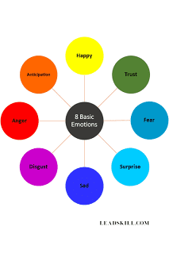
The next step is to have a tool or object that you can use each time you feel that emotion, which reinforces the emotion and being able to name it. This tool can then be used to communicate the emotion to another person. There are various different tools available, and although the examples contain lots of different emotions. To start with you could simplify them to just have five emotions.
A feelings wheel - https://aca-arizona.org/resources/the-feelings-wheel/
using picture-based resources, e.g.:https://innovativeresources.org/resources/card-sets/stones-have-feelings-too/
using a mood app

Slide 18
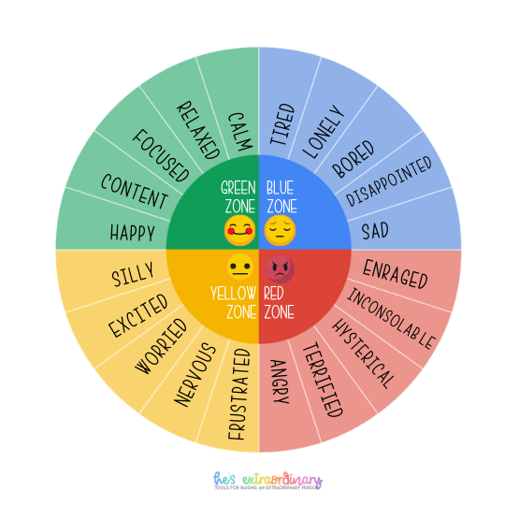
https://hes-extraordinary.com/

Slide 19
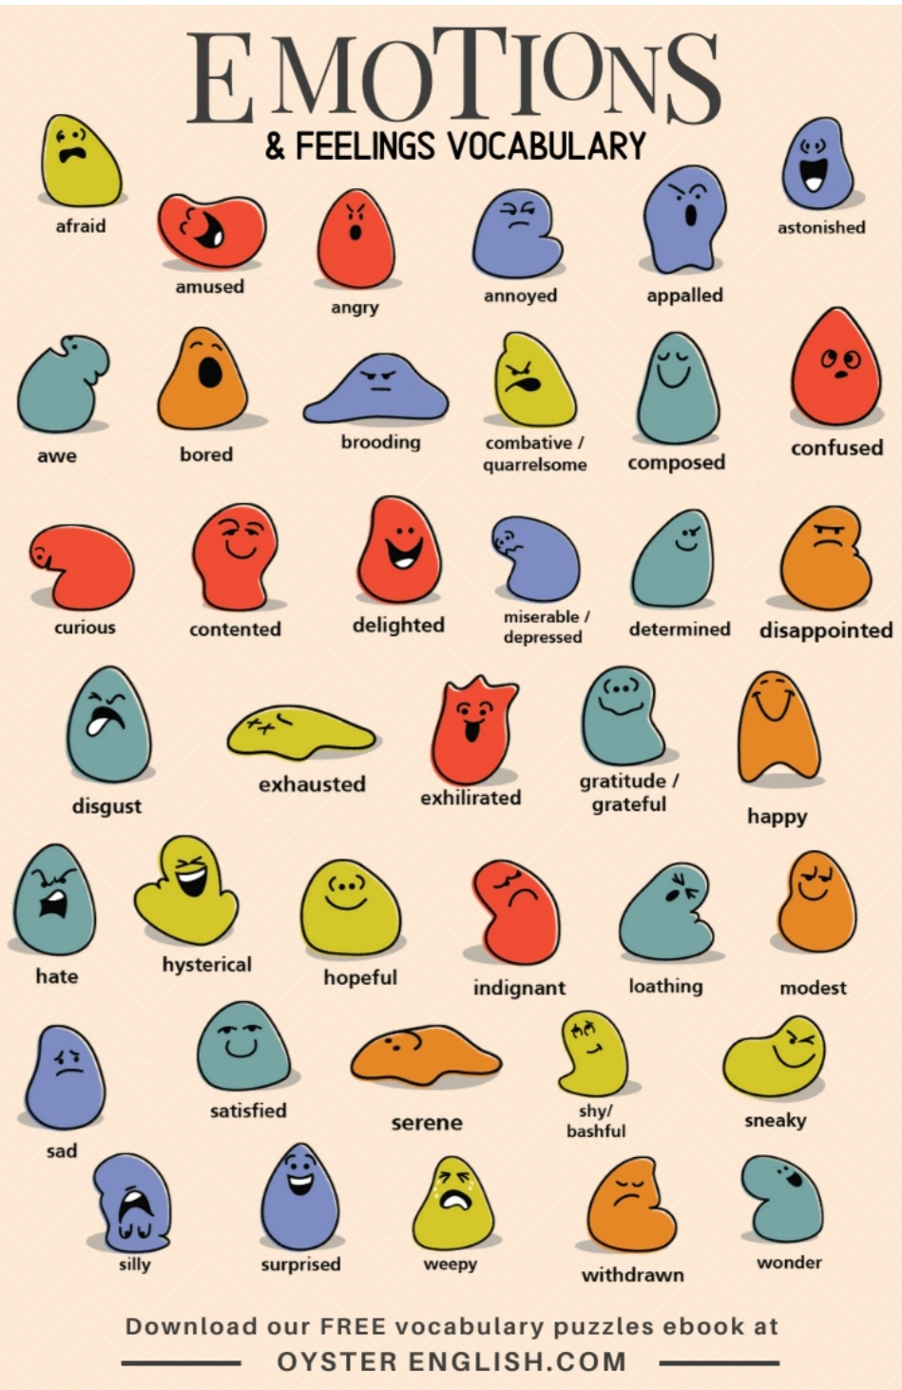
Using an ‘alphabet’ of emotions

Slide 20
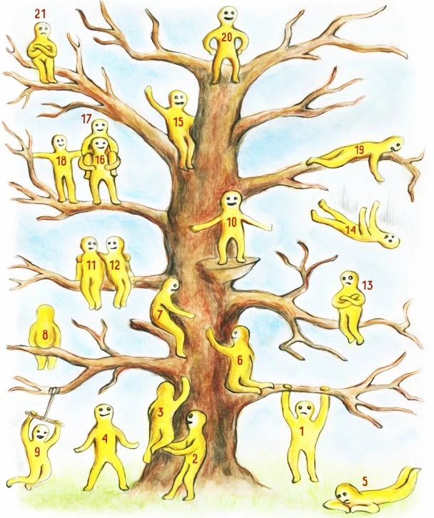
The ‘Blob’ or ‘jellybean’ tree

Slide 21
More strategies
Making a coloured card system, where you link that mood and feeling to a colour, and make a card with the name of the emotion on and possibly an image that helps you connect to that emotion.
Traffic light system.
Using items that you can relate to that demonstrate those emotions, such as something that is angry, something that is upset, and using these as objects or pictorial references.
Making an emotional dictionary - containing information of the name of the emotion, pictures, descriptive information especially about how you felt, or what you observed within yourself.

Slide 22
More strategies
Communicate emotions by placing an object outside your door to let others know how you are feeling
Listening to music can evoke emotions and using lyrics can be helpful
Freeze frame scenes from soap operas or your favourite film/TV programme to represent different emotions.
A system to assist with asking for help. Put a picture or symbol on the fridge.
Have code words
Observe body language in others

Slide 23
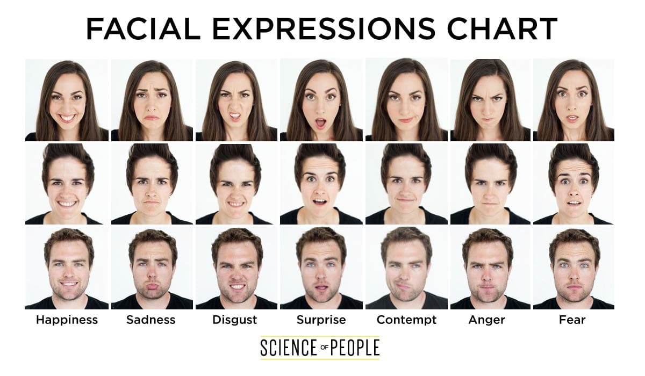

Slide 24
There is no right or wrong strategy to use, it is whatever you feel you can relate to and is helpful to you personally. Once you are able to consistently recognise five emotions, you can pick another emotion to add to your repertoire, using the same approach. These can be really helpful strategies to be able to communicate how you are feeling with someone else, as you can show them the item or ‘tool’ you are using.

Slide 25
Group discussion

Slide 26
Find out more or recap on this you tube video.
https://www.youtube.com/watch?v=WzHE7jL0i-A

Slide 27
Further resources
https://www.autistica.org.uk/what-is-autism/anxiety-and-autism-hub/alexithymia
https://unapologeticallyautistic.com/alexithymia-and-autism/
https://www.mind.org.uk/media/4400/autism-guide-web-version.pdf
https://www.scienceofpeople.com/microexpressions/

