Slide 1
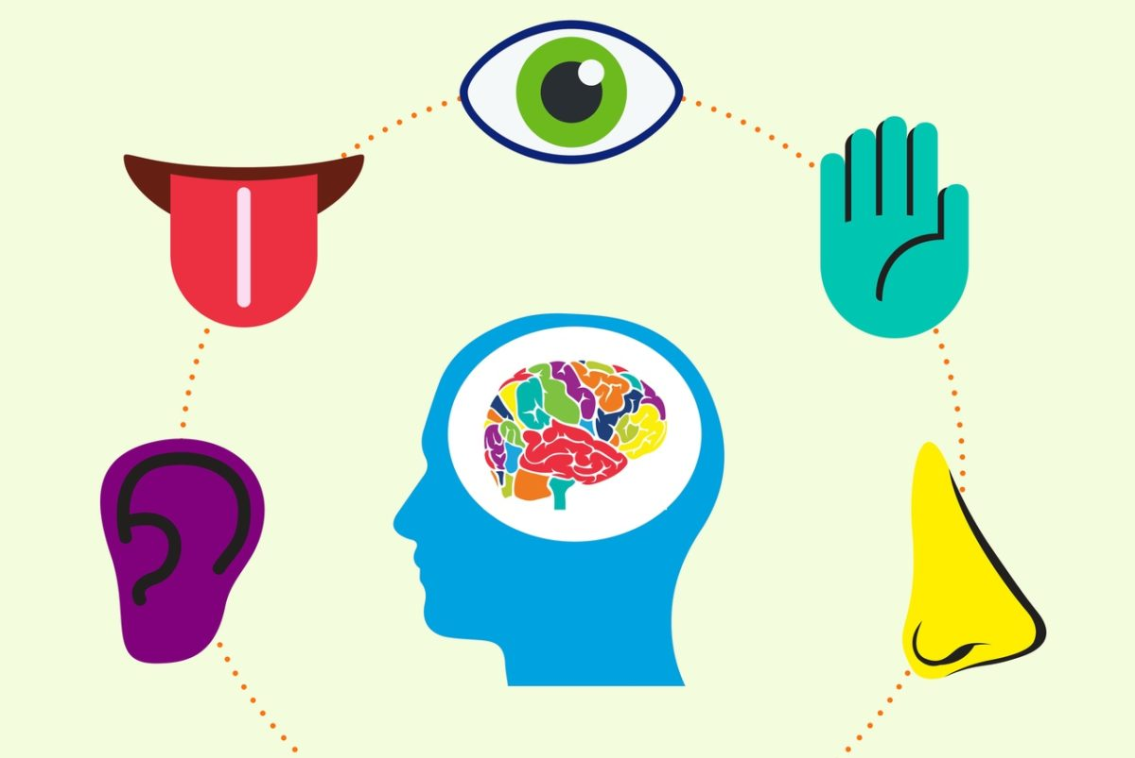
Understanding sensory processing and strategies
Adult ASD Service

Slide 2
Autistic people may experience sensory processing differences. If you are autistic, you may be over-sensitive or under-sensitive to sights, sounds, tastes, textures and smells. These differences can be positive and a strength however, sometimes they can also cause distress or discomfort.
In this presentation we will talk about what sensory processing is, examples of sensory differences and discuss strategies that can help.

Slide 3
What is sensory processing?
Sensory processing is how the brain takes in information through our senses and interprets this information about the body and the environment around us. This is then used to control and organise the body.
We all receive information in individual ways through our senses and this enables us to respond to produce an action or a behaviour.

Slide 4
The eighth sense: Interoception
Interoception is a lesser-known sense that helps you understand and feel what’s going on inside your body.
People who have difficulties with interoception may find it tricky to recognise when they feel hungry, full, hot, cold, or thirsty. They may also find it hard to recognise and regulate their emotions.

Slide 5
When can sensory processing become a problem?
A person with autism and sensory processing difficulties may get too much or not enough stimulation from their environment. This can become a problem when sensory experiences and resulting behaviours stop people from participating in everyday activities and inhibit their ability to regulate their emotions. These experiences can lead to people feeling overwhelmed and people can experience sensory overload. Sensory overload can cause anxiety, stress, pain, behavioural outburst, meltdowns or shutdowns.

Slide 6
How sensory overload can impact an autistic person
Sensory overload can impact an autistic person and their ability to carry out everyday tasks. A person may feel very overwhelmed when engaging in tasks such as visiting the supermarket, using public transport or attending work and education. This can be due to the sensory experiences in that environment. In a supermarket there may be music in the background, someone talking on a tannoy, customers talking, tills beeping, food smells and harsh lighting. All of these things combined can be very overwhelming to take in and process all at once. These experiences can lead to people avoiding situations, becoming isolated and anxious.
There are many ways that sensory overload can be avoided through learning about our own sensory preferences and adapting the environment around us.
https://www.youtube.com/watch?v=K2P4Ed6G3gw
This video is good for supporters to watch to gain an insight on sensory overload, but can be too intense for some people with autism

Slide 7
Considerations on how to support someone that experiences sensory overload
If you are having a meltdown, or not responding there are things that you can do to help. Often, small changes to the environment can make a difference. Keeping a diary or log of your meltdowns and thinking about what happened before, during and after can be helpful in recognising how and when you may be experiencing sensory overload and can be helpful in highlighting strategies.
Three points to remember are:
Be aware. Look at the environment to see if it is creating difficulties. Can you change anything?
Be creative. Think of some positive sensory experiences that you enjoy and can incorporate into your day to day life.
Be prepared. Research in advance about possible sensory stimuli that you may experience in different environments. (NAS 2021).
Some other things to consider are; having access to a lower stimulus space, having time to process information, access to a safe space to calm down and rest after experiencing a meltdown or shut down. A lot of people will feel exhaustion afterwards and will benefit from this time to rest and recover.

Slide 8
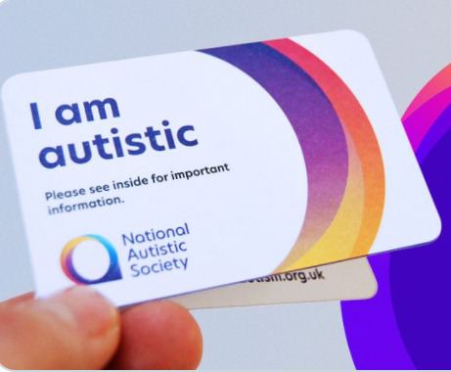
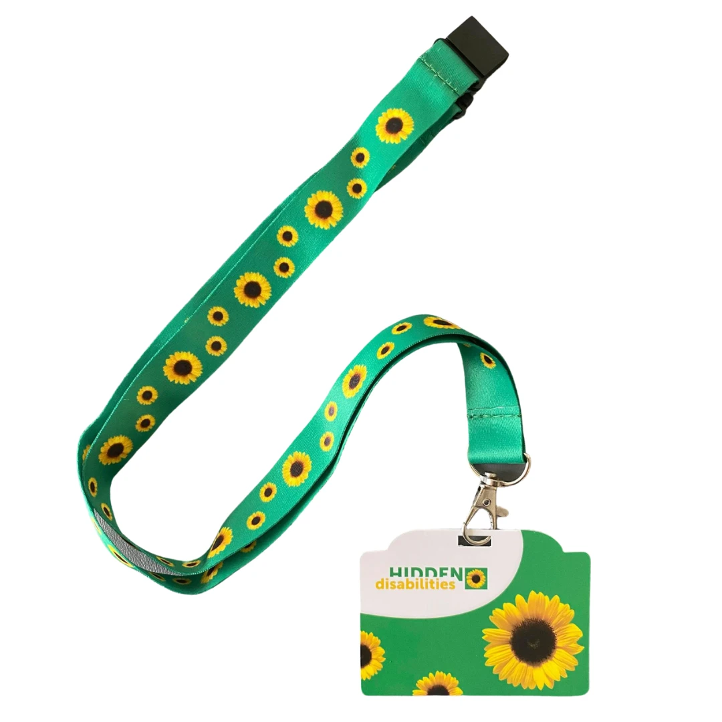
Resources that can be used to communicate sensory needs
Autism alert card
This card is a great way for people to let the public know they are autistic and that they may need some extra time or help in certain situations. Download the I Am Autistic Card for free, here: I am autistic card (autism.org.uk). You can also get an autism alert card from Amazon or Ebay and CHAPS: https://www.cheshireautism.org.uk/news/attention-card/. The CHAPS alert card is linked with Merseyside and Cheshire emergency services.
Other examples of resources include:
Hidden disabilities lanyard scheme
https://hiddendisabilitiesstore.com/shop.html
Hospital passport
https://www.autism.org.uk/advice-and-guidance/topics/physical-health/my-health-passport

Slide 9
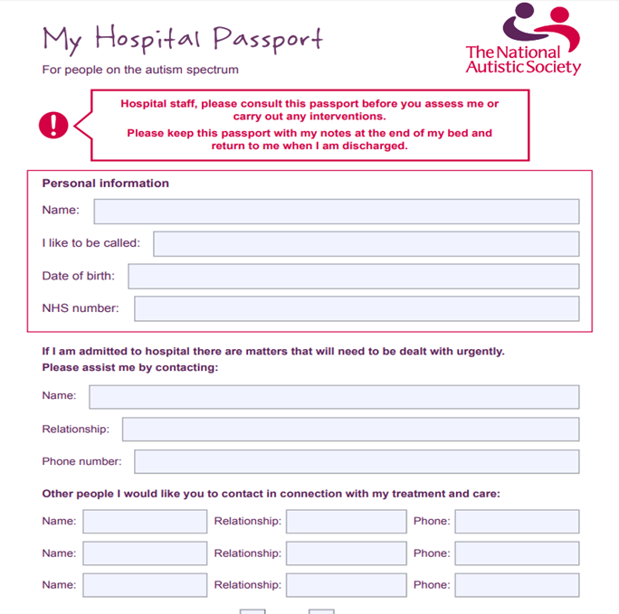
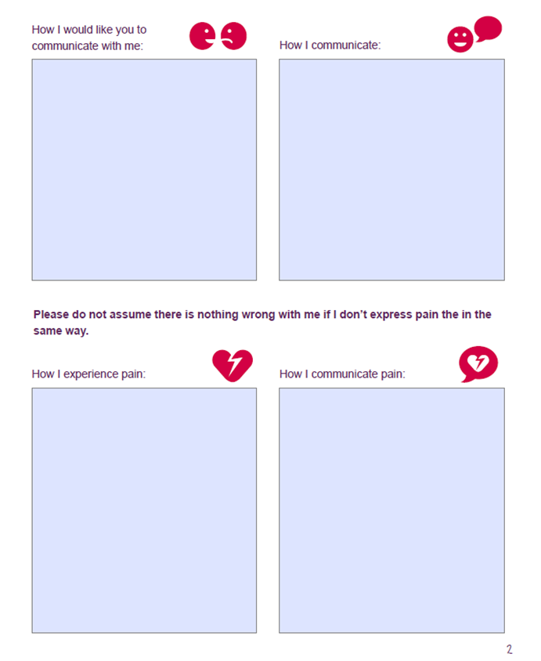
Hospital passport
Some autistic people find going to medical appointments or hospital overwhelming. A hospital passport is a helpful tool to help communicate your needs and takes into consideration sensory processing difficulties such as interoception.

Slide 10
Understanding and learning how we process sensory information as individuals
Our bodies are like a car engine. Sometimes you may feel like your body is running in……
High speed
Low speed
Just right

Slide 11
Understanding how we process sensory information can help us to identify helpful strategies
When your engine is high speed you may find it difficult to pay attention, to sit still, quietly and get your work completed.
When your engine is low speed you also may find it difficult to concentrate, you may daydream easily.
If you want to change your engine speed from high or low to get into the “just right” feeling- you may need to try different things……
When you are in the “just right” place, its usually easier to pay attention, to get your work done.

Slide 12
Appendices

Slide 13
Sight
UNDER-SENSITIVE
Objects appear quite dark, or lose some of their features
Central vision is blurred but peripheral vision quite sharp
A central object is magnified but things on the periphery are blurred
Poor depth perception, difficulties with throwing and catching, clumsiness.
OVER-SENSITIVE
Distorted vision - objects and bright lights can appear to jump around
Images may fragment
Easier and more pleasurable to focus on a detail rather than the whole object
Has difficulty getting to sleep as sensitive to the light.
Strategies:
You could make changes to the environment, such reducing fluorescent lighting, providing sunglasses, using blackout curtains and/or creating a workstation in the classroom - a space or desk with high walls or divides on both sides to block out visual distractions.

Slide 14
Sound
UNDER-SENSITIVE
may only hear sounds in one ear, the other ear having only partial hearing or none at all
may not acknowledge particular sounds
might enjoy crowded, noisy places or bang doors and objects.
You could help by using visual supports to back up verbal information, and ensuring that other people are aware of the under-sensitivity so that they can communicate effectively. To meet the person’s individual sensory need, include experiences they enjoy in their daily timetable.
OVER-SENSITIVE
noise can be magnified and sounds become distorted and muddled
may be able to hear conversations in the distance
inability to cut out sounds – notably background noise - leading to difficulties concentrating.
Strategies:
shutting doors and windows to reduce external sounds
preparing the person before going to noisy or crowded places
providing ear plugs and music to listen to
creating a screened workstation in the classroom or office, positioning the person away from doors and windows.

Slide 15
Smell
UNDER-SENSITIVE
some people have no sense of smell and fail to notice extreme odours (this can include their own body odour, bad food smells or gas).
some people may lick things to get a better sense of what they are.
You could help by creating a routine around regular washing and using strong-smelling products to distract people from inappropriate strong-smelling stimuli.
OVER-SENSITIVE
smells can be intense and overpowering. This can cause toileting problems
dislikes people with distinctive perfumes, shampoos, etc.
Strategies:
Unscented detergents or shampoos, avoiding wearing perfume, and making the environment as fragrance-free as possible. Some people find certain smells calming so providing them with a sensory kit with their favourite scented candle, perfume or toiletries can be a helpful strategy in feeling calmer and reducing the speed of their ‘engine.’

Slide 16
Taste
UNDER-SENSITIVE
likes very spicy foods
eats or mouths non-edible items such as stones, dirt, soil, grass, metal, faeces. This is known as pica.
OVER-SENSITIVE
finds some flavours and foods too strong and overpowering because of very sensitive taste buds. Has a restricted diet
certain textures cause discomfort - may only eat smooth foods like mashed potatoes or ice-cream.
Strategies:
Working with a persons preferences to ensure they get a varied diet.
Some people eat really sour foods or sweets to increase the rate of their ‘engine’.
Some people may limit themselves to bland foods or crave very strong-tasting food. As long as someone has some dietary variety, this isn't necessarily a problem.

Slide 17
Touch
UNDER SENSITIVE:
Holds others tightly
Has a high pain threshold.
May be unable to feel food in the mouth – food could be left around face / messy eater.
Likes to chew objects
OVER SENSITIVE:
Touch can be painful and uncomfortable - people may not like to be touched and this can affect their relationships with others.
Dislike having anything on hands or feet.
May remove labels in clothing.
May find some food or material textures uncomfortable.
Particular about the way clothes or shoes feel.
Strategies:
warning prior to being touched, and approach from the front so its predictable.
remembering that a hug may be painful rather than comforting. Agree a hug, at a calm time.
Working with clothing / food preferences.
gradually introducing different textures of touch, eg have a box of materials available that are tolerated – feathers, calming massage oils, warm stones etc.
Eat in front of a mirror or wash / check face after eating, or use a napkin.
Be aware of how tightly you hold people.
for chewing, - chewing gum, or crunchy foods (raw granola, raw carrots etc).

Slide 18
Vestibular (Balance)
UNDER-SENSITIVE
a need to rock, swing or spin to get some sensory input.
You could encourage activities that help to develop the vestibular system. This could include using rocking horses, swings, roundabouts, seesaws, catching a ball or practising walking smoothly up steps or curbs.
OVER-SENSITIVE
difficulties with activities like sport, where we need to control our movements
difficulties stopping quickly or during an activity
car sickness
difficulties with activities where the head is not upright or feet are off the ground.
Strategies:
breaking down activities into small, more easily manageable steps and using visual cues such as a finish line.
Using technology as an alternative (Nintendo Wii)
Do movement activities, such as swinging, ball games, running, trampolining, swimming etc, at appropriate times of the day.

Slide 19
Proprioception (Movement and body in space)
UNDER-SENSITIVE
stands too close to others, because they cannot measure their proximity to other people and judge personal space
finds it hard to navigate rooms and avoid obstructions
may bump into people.
Strategies:
positioning furniture around the edge of a room to make navigation easier
using weighted blankets to provide deep pressure
putting coloured tape on the floor to indicate boundaries
using the 'arm's-length rule' to judge personal space - this means standing an arm's length away from other people.
OVER-SENSITIVE
difficulties with fine motor skills, eg manipulating small objects like buttons or shoe laces
moves whole body to look at something.
Strategies:
offering 'fine motor' activities like lacing boards.
Wii fit balance board and yoga pose activities, pilates, riding a bike, swimming, trampolining.

Slide 20
Interoception
UNDER-SENSITIVE:
Struggles to feel or recognise emotions
Does not always feel when they are hungry, thirsty, tired or full so may over or under eat, may struggle with sleep
OVER-SENSITIVE:
Can notice and remember small details associated with feeling of emotion, pain, temperature, hunger or thirst
Unusual ability to notice small internal changes (e.g. digestion of food, changes in heart rate, etc)
You may show signs of distress when you are hungry, thirsty, hot/cold or tired.
Can feel overwhelmed by experiencing multiple sensations at one time and not able to differentiate what they are.
Strategies:
Completing a hospital passport to enable healthcare staff to recognise how you communicate pain and temperature. If you struggle to communicate when you are in pain you can include information about how you might behave if you are in pain such as; become socially withdrawn, sleep, cry, scream, shout, so healthcare staff or people close to you know what to look out for.
Use communication passports or communication cards to support you to express how you are feeling if you struggle to verbalise this yourself.
Use visual timetables and timers to remind you to stop eating and drinking if you struggle to feel full. You can use these strategies to meal plan accordingly if you feel hunger a lot more than usual.
Use visual portion control plates to indicate how much food to put on your plate.
Mindfulness helps us to tune into our bodies and recognise how we are feeling
Establishing a structured routine.
Developing a ‘sensory diet’ to help you to recognise how you are feeling and to help keep yourself regulated.

Slide 21
This can help us to identify things to help raise or lower your alertness
A similar checklist can be found here –
http://f-sepac.org/wp-content/uploads/2015/01/Sensory-Motor-Preference-checklist.pdf

Slide 22
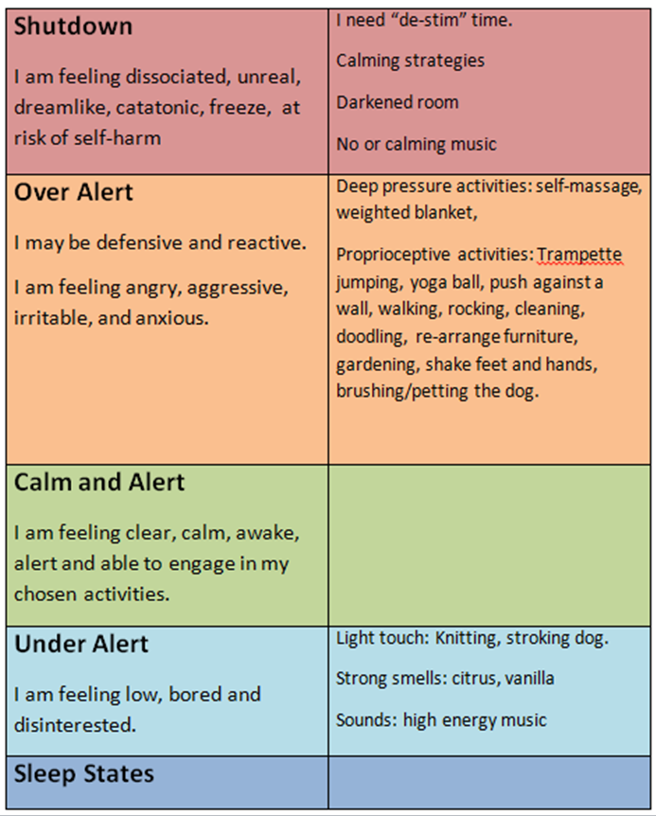
A sensory ladder tool can help to identify suitable sensory strategies to use in each arousal state, e.g. at shutdown, when over alert, when calm and alert, when under alert and in sleep states.

Slide 23
Summary
We hope that you have learnt some information about sensory processing and the experiences that autistic people can often have. We hope that this has provided some tools and information to help you develop some useful strategies

Slide 24
References
National Autistic Society website:
https://www.autism.org.uk/advice-and-guidance/topics/sensory-differences/sensory-differences/all-audiences
https://www.understood.org/articles/en/interoception-and-sensory-processing-issues-what-you-need-to-know
Gillingham G. (1995) Autism: handle with care!: understanding and managing behavior of children and adults with autism. Future Education Inc
Further reading and resources:
Some ideas of things you could do at home can be found here in our sensory video: https://youtu.be/P4KgTsq9QbQ
Laurie, C. (2014) Sensory Strategies London: The National Autistic Society
Higashida, Naoki (2014) The Reason I Jump: One boy’s voice from the silence of autism. Sceptre

Slide 25
Further Information
There are various online sensory shops for equipment and tools:
https://www.sensorytoywarehouse.com
https://www.sensorydirect.com/?gclid=Cj0KCQjw--GFBhDeARIsACH_kdZkPj5Y3cWaF4oKdgx4ZVI8644Q_b_QIdIFJeD_cR8PEdBJWuINSDsaAm64EALw_wcB
https://www.sensorytoysuk.co.uk
Sensory toolkit: https://thespiralfoundation.org/adults-and-adolescents-toolkit/
Grandin, T. (2006) Thinking in Pictures. Bloomsbury Publishing
Purple Ella, Sensory processing video: AUTISM AND SENSORY PROCESSING|Purple Ella - YouTube

